Slide 1
Text Analytics 101
Rayid Ghani

Slide 2
What we’ll cover today
What kinds of analyses can be done with text data?
How do to those analyses?
What are those analyses useful for?

Slide 3



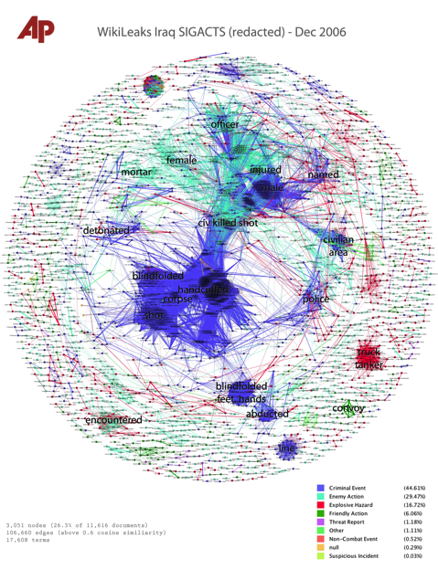
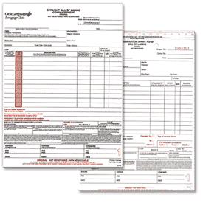

Where does text data come from?

Slide 4
Why is text data different?
Structured Data: Humans have already pre-determined the attributes and relations of interest (e.g. relational databases)
Text data can have too many possible dimensions (millions)
Text data often reflects human observations that are exceptions to regular business processes.
Complaints, Suggestions, (the ubiquitous “other” field)

Slide 5
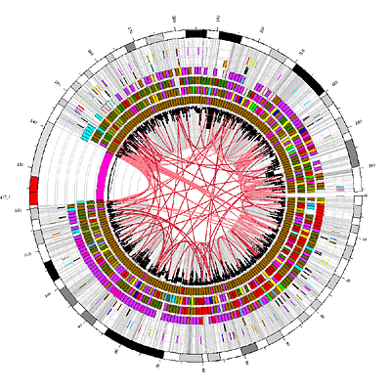
Text Analytics: Capabilities
Search
Classification
Clustering
Extraction
Summarization
Visualization

Slide 6
Text mining platforms require a variety of capabilities
Capability | Description | Maturity
Classification | Classification of a document into one or more previously defined content categories. (e.g. Classify incoming emails as personal, business, news article, etc.) | High
Word Clustering / Synonyms | Finding groups of words that are similar to each other. Depending on the strictness of the definition of similarity, similar words can be synonyms (IBM, Deep Blue) or companies in similar industry (Oracle, Teradata) | Low
Topic Detection / Clustering | Finding emerging or existing topics in large amounts of text data. Clustering news articles can help detect emerging topics. | High
Opinion & Sentiment Analysis | Detection of sentiment and opinions in different levels of granularity (word, sentence, message). | Medium
Named Entity Extraction (People, Locations, Organizations) | Recognition, tagging, and extraction of named entities of type Person, Location, and Organization. Typically limited to proper nouns and not much customization possible. | High
General Extraction (Entities, Events, Facts, Relationships) | Recognition, tagging, and extraction of specified classes of words /phrases as an entity (client, competitor, company), event (acquisition), relationship (John King works for MSFT) | Low
Search | Ranked retrieval of a document or component based on the presence of one or more supplied search terms. | High
Visualization | Visualization of text data and /or visual mashups combining text with other forms of data (maps, networks, etc). | Medium
Summarization | Summarization of a document, intended to produce a readable abstract of the source document which captures salient points using fewer words. | Low
6
Notes:
Add entity extraciont separate

Slide 7
Different Text analytics paradigms: Best is to use statistical machine learning augmented with lexicons and linguistics
 | Lexicon-based Rules | Linguistic Rules | Statistical Machine Learning (augmented with linguistics & lexicons)
Description | Rules based on lists of words | Rules using words and linguistic operators (parts of speech for example) | Statistical approaches that can be trained and learn over time. Can incorporate lexicons and linguistics as well
Ease of creation & maintenance | Low | Low | High
Accuracy | Low | Medium | High
Context Sensitiveness | Low | High | High
Interpretability | High (unless the rules get large) | Medium | Medium
Do it by hand
Hire linguists
Do it the right way

Slide 8
Today we’re going to
Explore a new text corpus to understand what’s in it
Build classifiers to scale human tagging / classification

Slide 9
How do we do Machine Learning with Text Data?
Everything we covered in the last two days with Machine Learning applies here if we can convert text data into rows and columns/features

Slide 10
Simple ways of text to “data” conversion
Treat each word as a column/variable/feature
Remove, Combine, Transform, Abstract some words

Slide 11
Natural Language Processing Pipeline
Pre-Processing
Add Linguistic Features
Convert to a Matrix
Analysis
Optional

Slide 12
Raw data from a webpage
<div><p class=header>Our mission is to provide comprehensive ;nbsp social services to refugees to help them overcome the societal and language barriers and become productive members of the US society. </p></div>

Slide 13
NLP Pipeline – Pre-Processing
Clean Text
Tokenize
Stemming
Remove Stopwords
Remove rare words
<div><p class=header>Our mission is to provide comprehensive ;nbsp social services to refugees to help them overcome the societal and language barriers and become productive members of the US society. </p></div>

Slide 14
NLP Pipeline – Pre-Processing
Clean Text
Tokenize
Stemming
Remove Stopwords
Remove rare words
Our mission is to provide comprehensive social services to refugees to help them overcome the societal and language barriers and become productive members of the US society.

Slide 15
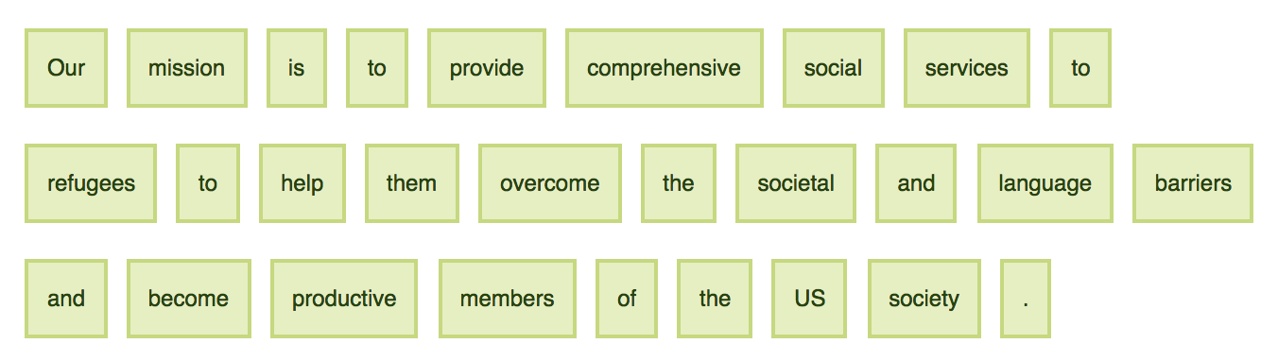
NLP Pipeline – Pre-Processing
Our mission is to provide comprehensive social services to refugees to help them overcome the societal and language barriers and become productive members of the US society.
Clean Text
Tokenize
Stemming
Remove Stopwords
Remove rare words

Slide 16
NLP Pipeline – Pre-Processing
Clean Text
Tokenize
Stemming
Remove Stopwords
Remove rare words
Our mission is to provid comprehens social servic to refuge to help them overcom the societ and languag barrier and becom product member of the US societi .

Slide 17
NLP Pipeline – Pre-Processing
Clean Text
Tokenize
Stemming
Remove Stopwords
Remove rare words
mission provid comprehens social servic refuge help overcom societ languag barrier becom product member US societi .

Slide 18
NLP Pipeline – Pre-Processing
Clean Text
Tokenize
Stemming
Remove Stopwords
Remove rare words
mission provid comprehens social servic refuge help overcom societ languag barrier becom product member US societi .

Slide 19
NLP Pipeline – Pre-Processing
PRP$ Our NN mission VBZ is TO to VB provide JJ comprehensive JJ social NNS services TO to NNS refugees TO to VB help PRP them VB overcome DT the NN societal CC and NN language NNS barriers CC and VB become JJ productive NNS members IN of DT the NNP US NN society . .
Part of Speech Tags
Chunking
Parsing
PRP Personal Pronoun
IN Preposition
NN Singular Noun
VBZ Verb, 3rd ps. sing. present

Slide 20
NLP Pipeline – Pre-Processing
NP Our mission VP is VP to provide NP comprehensive social services PP to NP refugees VP to help NP them VP overcome NP the societal and language barriers and VP become NP productive members PP of NP the US society .
Part of Speech Tags
Chunking
Parsing
NP | Noun Phrase
VP | Verb Phrase
PP | Prepositional Phrase

Slide 21
NLP Pipeline – Turning in to a Matrix
What do you want the columns to be?
Words, phrases, POS tags, …
What value do you put in a cell?
If a word appears in a document – binary variable
# of times a word in a document – word frequency
Words that uniquely characterize this document - tfidf

Slide 22
TFIDF – Term Frequency Inverse Document Frequency
TF = Term Frequency (word count/ # words in the document)
IDF = Inverse Document Frequency (how many documents does this word occur in?) log (# total documents / # documents this word appears in)
TFIDF = TF X IDF

Slide 23
highest when the word occurs many times within a small number of documents (thus lending high discriminating power to those documents)
lower when the word occurs fewer times in a document, or occurs in many documents
lowest when the word occurs in virtually all documents.

Slide 24
Analysis: Topic Models
“Soft” clustering for analyzing text corpora
Topic: probability distribution over words
Document: probability distribution over topics
Generative Model - To generate a document:
First select a topic
Then generate words from that topic’s distribution
Repeat
Latent Dirichlet Allocation (LDA) is the most common method

Slide 25
Topic Models
Python libraries
Gensim
Lda
pyLDAvis is a python libarary for interactive topic model visualization

Slide 26
Other NLP Components
Named Entity Recognition (NER)
Part of Speech Tagger
Parser

Slide 27
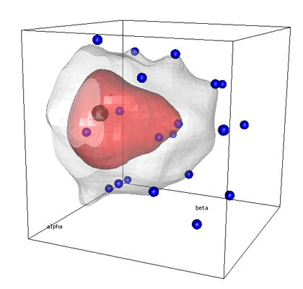

Statistical Machine Learning based approaches compensate for the shortcomings of rule-based systems
Model Training
Operational Use
“Is this narrative about crime?”
“Is this narrative about crime?”
Training Set
New Messages
✓
?
✗
Statistical Learning Algorithm
Machine Learning Model
✗
?
✓
✗
Model Trainer / Reviewer
Model Trainer
?
✓
✗
Lexicons
Update Model
Benefits of Machine Learning
Significantly cheaper approach to achieve a given level of accuracy compared to manual rule or lexicon creation
No advanced linguistic or technical skills to train and maintain the system (business users or analysts are the maintainers)

Slide 28
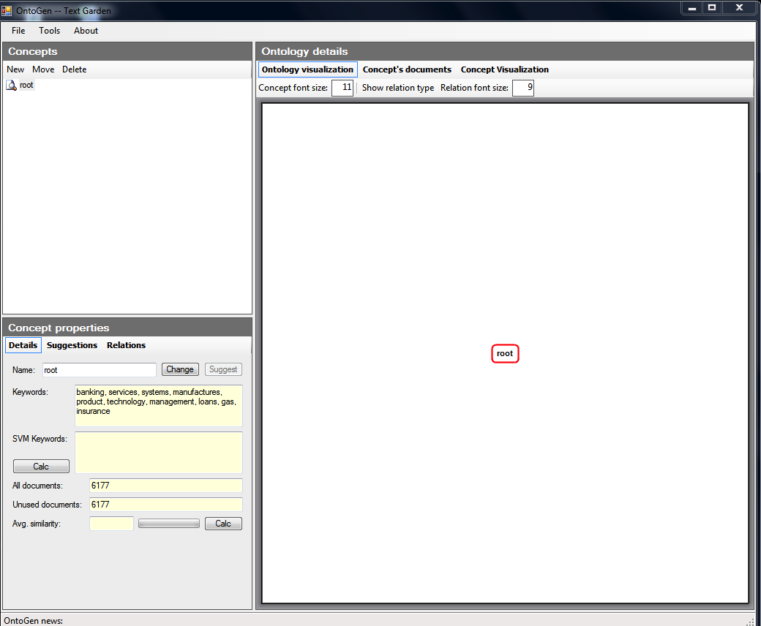
OntoGen: Interactively discovering topics and themes in large amounts of text data

Slide 29
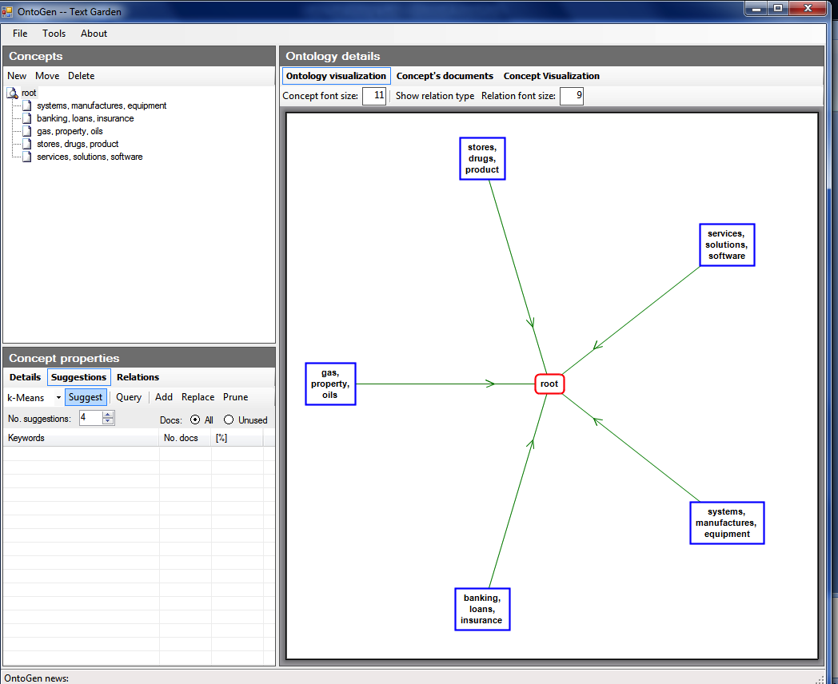
OntoGen: Interactively discovering topics and themes in large amounts of text data

Slide 30
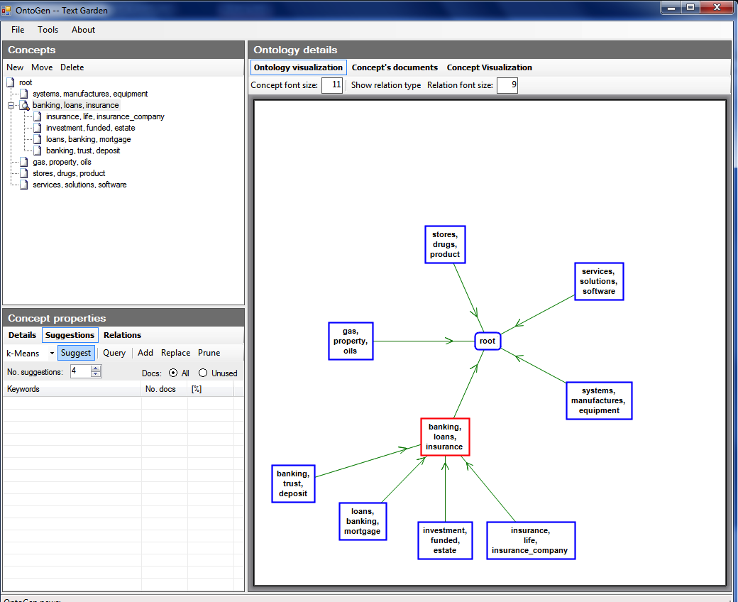

Slide 31
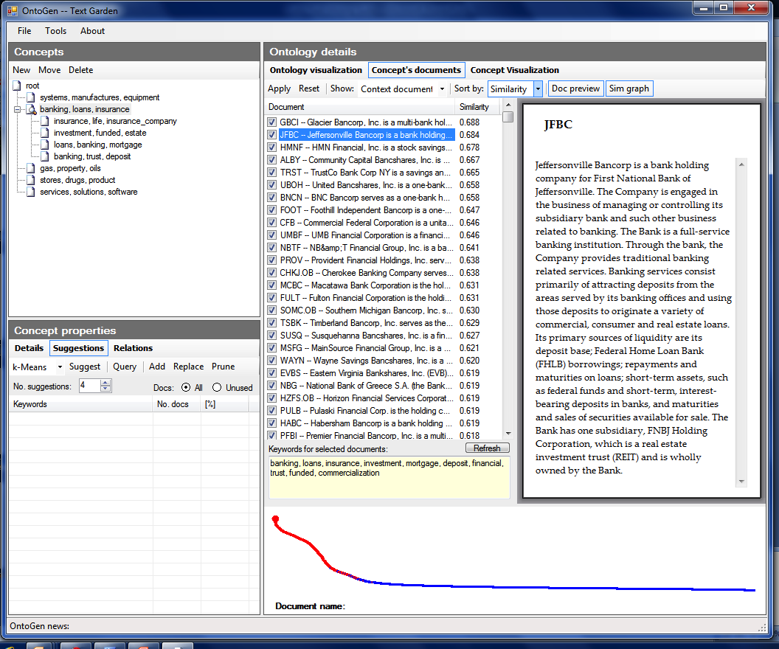

Slide 32
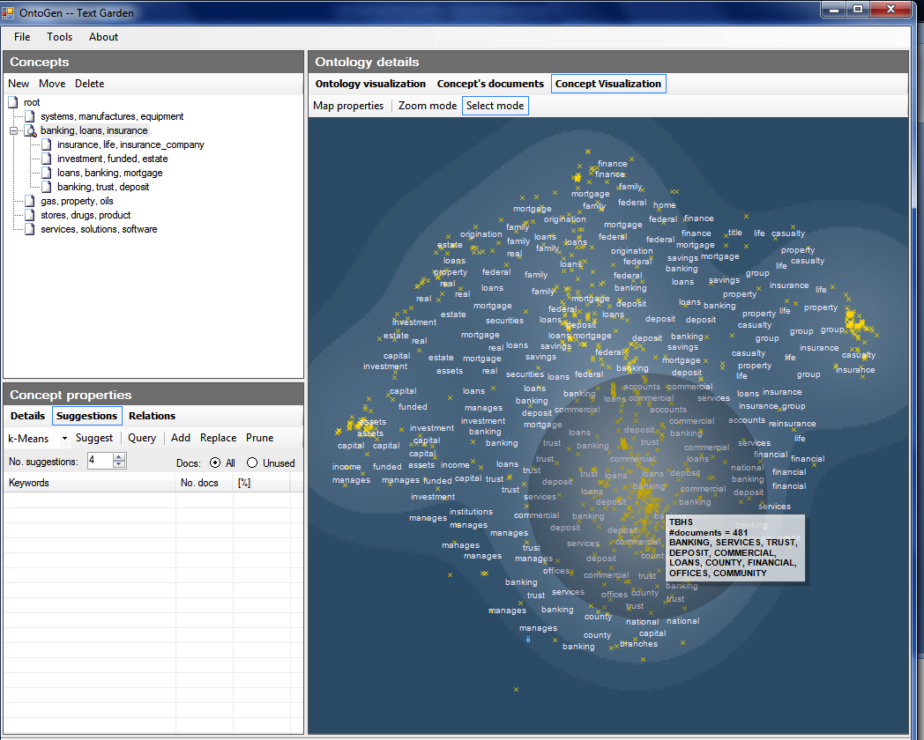

Slide 33
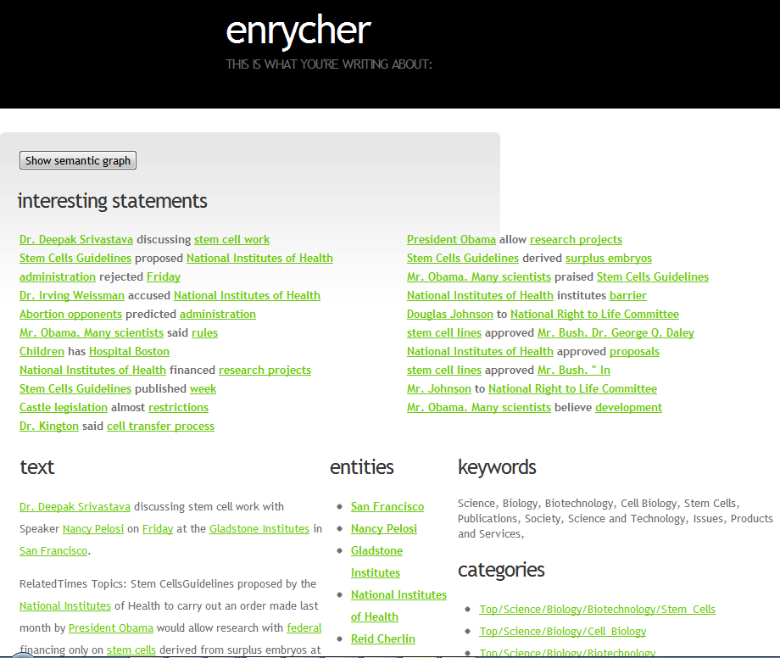

Slide 34
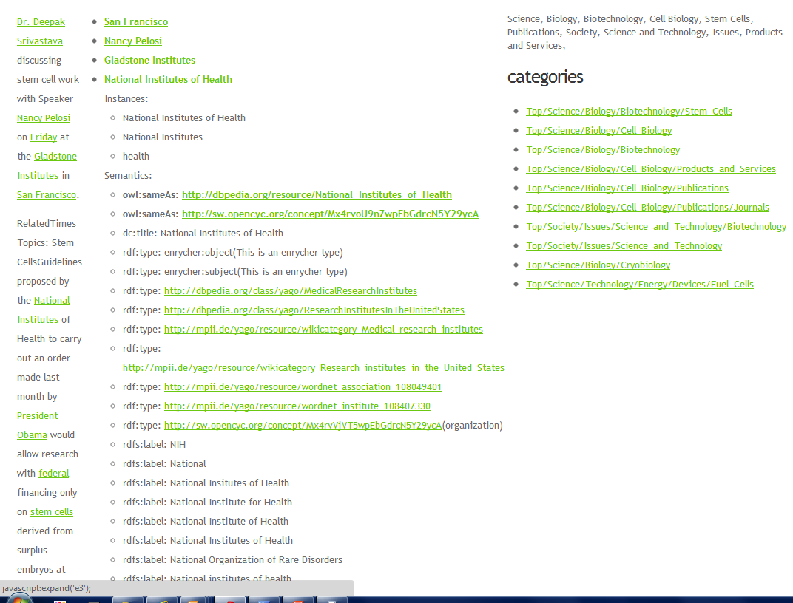

Slide 35
Python Toolkit - NLTK
Book at http://www.nltk.org/
Useful scripts in nltk-trainer
You can also combine nltk and sklearn to do pre-processing in nltk and classification in sklearn
http://streamhacker.com/tag/classification/

Slide 36
Online Resources
Interactive clustering tool Ontogen: ontogen.ijs.si
Tutorial at http://eprints.pascal-network.org/archive/00000017/01/Tutorial_Marko.pdf
Demos
http://cogcomp.cs.illinois.edu/page/demos/
https://dandelion.eu/semantic-text/text-classification-demo
List of commercial software http://www.kdnuggets.com/software/text.html

Slide 37
Python Toolkit - NLTK
Book at http://www.nltk.org/
Useful scripts in nltk-trainer
http://brandonrose.org/clustering

Slide 38
Open Source NLP Toolkits
Apache OpenNLP
Natural Language Toolkit (NLTK)
Standford NLP
MALLET

Slide 39
Online Resources
Interactive clustering tool Ontogen: ontogen.ijs.si
Tutorial at http://eprints.pascal-network.org/archive/00000017/01/Tutorial_Marko.pdf
Online lectures at videolectures.net
List of commercial software http://www.kdnuggets.com/software/text.html

